Slide 1
Lean Accounting
Management Accounting in a Lean Environment

Slide 2

Other Modules In This Series:
5S
Standard Work
Total Productive Maintenance (TPM)
Administrative Lean
Cell Design/ Production Preparation Process (3P)
Kaizen
Kanban
Problem Solving
Poka Yoke Quality Systems
Transaction Process Improvement (TPI)
Cause & Effect Diagram with the Additions of Cards (CEDAC)
Single Minute Exchange of Dies (SMED)
Value Stream Mapping (VSMi®)
Visual Management
Managing Daily Process Excellence
For More Information Please Contact:
Mark DeLuzio, President and CEO
+1.860.234.0915
mark.deluzio@leanhorizons.com
Strategically Creating Value Through the Elimination of Waste

Slide 3
This document contains confidential
and proprietary information owned
by Lean Horizons Consulting, LLC.
Any disclosure, use, copying or
distribution of this information without the express written consent of Lean Horizons Consulting is strictly prohibited.

Slide 4
Ground Rules for Event
Active participation by all
Start and end on time
All electronic gadgets (phones, pagers, etc.) turned to “off” or “silent.”
Computers to be used only when instructed
Keep an open mind to change
Don’t let “perfect” get in the way of “better.”
Notes:
DO: Ask the group if they have any ground rules to add (capture them on chart paper).
Ask the group if they agree to these ground rules.
DO: Perform Group Introductions

Slide 5
Goal of the Introduction to Lean Experience
To identify how traditional accounting practices do not support Lean efforts in an organization and the need to establish an Accounting Management System for Lean success.
Lean
Fundamentals
Strategic
Deployment
Lean
Fundamentals
LBS Tools
LBS
Infrastructure
Cultural
Change

Slide 6
Why do accountants need to understand Lean?
Lean is a cultural change
Lean changes the entire organization
Without understanding Lean, the accountant will never understand why accounting systems must change
Accountants resist “throwing away” traditional accounting beliefs—they are therefore viewed as impediments to progress in a Lean world
Lean Education and Shop Floor Education is critical
  Move your desk if necessary!
Accountants can destroy a Lean Implementation

Slide 7
Lean Fundamentals
Lean Fundamentals
Problems with Traditional MAS
Lean Impact on MAS
Objectives:
Define lean
Define and identify hidden wastes
Differentiate Batch and Queue Manufacturing from Cellularization and Flow Production
Identify key Lean tools and their interrelationship
Notes:
DO: Explain that you will discuss the difference between push and pull systems. Remind the class of the definition of a Kanban system.
DO: Review objectives of this section.

Slide 8
What Is Lean?
Lean Fundamentals
First, let’s describe what Lean is not
  Not an inventory reduction program
  Not a headcount reduction program
  Not a key supplier program
  Not the re-configuration of a shop into cells

Slide 9

What is “Lean?”
Lean Fundamentals
“The relentless pursuit of the elimination of waste from every business process with the ultimate goal of providing World-Class quality, delivery and service to our customers at the lowest possible cost.”
Notes:
NOTE: Lean creates the need for less effort, less equipment, less time, less space…

Slide 10


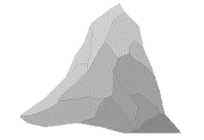



Lean Fundamentals
Sample Drivers of Waste
Sea of Excess Inventory, Manpower, Equipment
Long
No Standard Work
Set-Up
Time
Poor
Machine
Poor
Quality
Down-Time
Lack of
Scheduling
Training

Slide 11
From Batch to 1-Piece Flow
Lean Fundamentals
PC Board Assembly Dept.
Wave Solder Dept.
Packing Dept.
Stockroom
Final Assembly Dept.
Testing Dept.

Slide 12
Lean Cell Layout
Lean Fundamentals
Significantly reduces:
  Transportation
  Inventory
  Floor space
  Waiting time
While improving:
  Quality
  Delivery
  Cost
Final Assembly
Testing
Wave Solder
PC Board Assembly
Packing
Customer
Raw Material

Slide 13
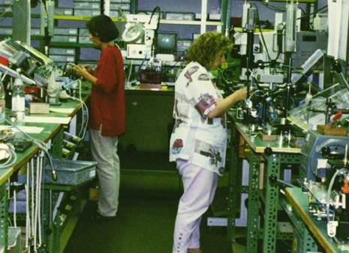
Cellular Production
Lean Fundamentals

Slide 14
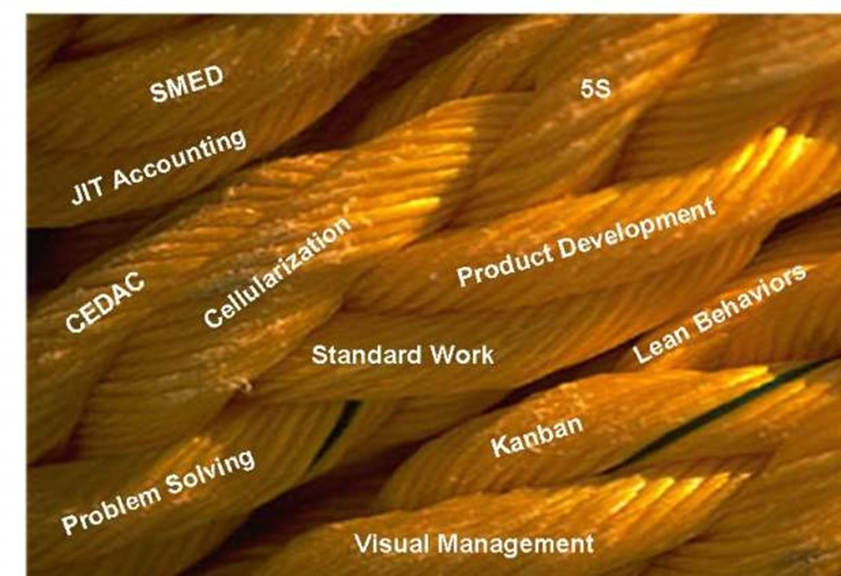
The Tools of Lean are Intertwined
Lean Fundamentals

Slide 15
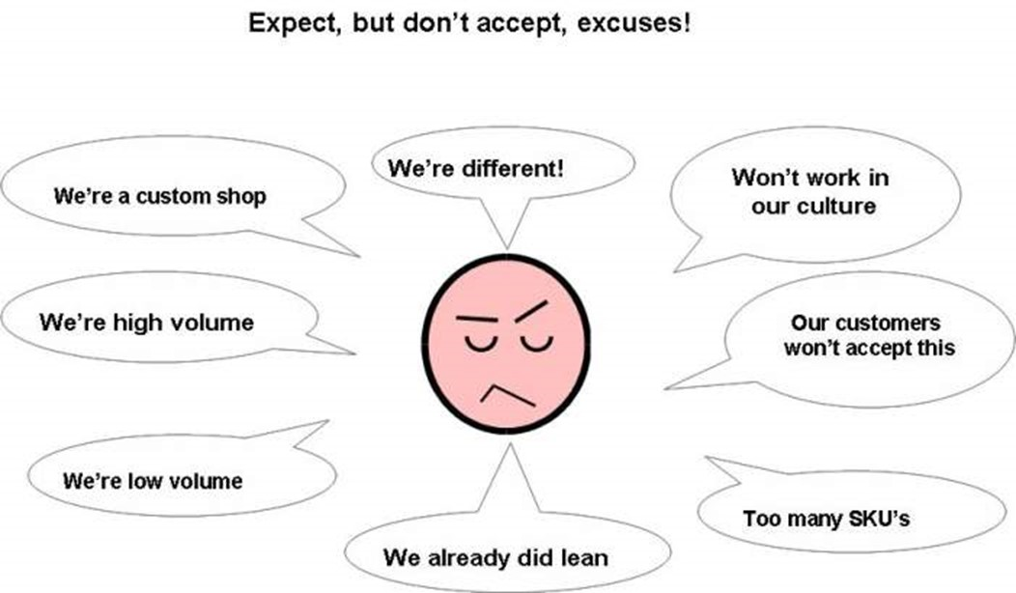
Common Excuses Cause Failure
Lean Fundamentals

Slide 16
Key take-away
Lean Fundamentals
Upper Management Commitment is Critical to success!

Slide 17
Problems with Traditional Management Accounting Systems (MAS)
Lean Fundamentals
Problems with Traditional MAS
Lean Impact on MAS
Objectives:
Identify key factors of Traditional Accounting Systems
Identify problems with using Standard Cost Variance Analysis
Discuss how Variance Analysis does not support kaizen philosophy
Identify impact of traditional labor accounting
Identify impact of traditional scrap reporting
Identify impact of traditional capital justification

Slide 18
Traditional Accounting Systems
Problems with Traditional MAS
Traditional Accounting Systems will not work in a Lean environment
Traditional Accounting Systems were designed to service
  External Customers
  The IRS
  The SEC
  Auditors
  Those guys at corporate!

Slide 19
Traditional Accounting Systems
Problems with Traditional MAS
Failed to recognize that one of their most important customers is manufacturing!
Forced their systems on others
Accountants ‘thought’ they had control
Required manufacturing to do non-value added things
  Controlled stockroom
  Inventory Transactions
  Discrete Shop orders
  Labor Time Tickets etc.

Slide 20
Traditional Accounting Systems
Problems with Traditional MAS
As painful as these controls were, the accounting profession attempted to use the output from these systems to measure the performance of the manufacturing group
Financial Accounting and Managerial
Accounting are Different!!!

Slide 21
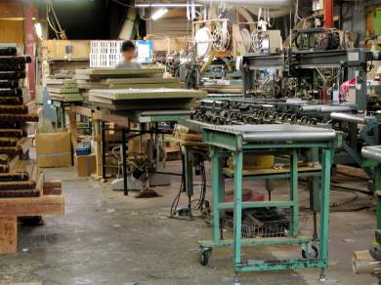
Standard Costs
Problems with Traditional MAS
Standard Costs are estimates of what you ‘think’ a product will cost to manufacture
Standards are wrong from the moment which they are developed!

Slide 22
The Problems With Using Standard Cost Variance Analysis
Problems with Traditional MAS
Variance Analysis often measures the wrong things. Dysfunctional behaviors are encouraged.
Variance analysis does not support or promote the kaizen (continuous improvement) philosophy.
Unsold Inventory

Slide 23
Purchase Price Variance Analysis
Problems with Traditional MAS
Material price standards are ‘weighted,’ therefore, variance analysis is not meaningful
PPV analysis promotes the use of volume discounts to keep unit price down
  Inventory levels rise
  Obsolescence increases
Promotes the use of the lowest “priced” supplier, not necessarily the lowest cost supplier
  Quality is compromised
  Rejects, rework, warranty increase

Slide 24
Purchase Price Variance Analysis
Problems with Traditional MAS
Supports the notion of producing as much as possible
High-Absorption products are produced regardless of demand requirements
Emphasis on absorption variances results in
  High inventory levels
  Decreased customer service levels
  Increased obsolescence
The definition of fixed costs is an area of concern
  Many costs are not truly fixed
  ‘Fixed’ suggests that improvements are not possible

Slide 25
Flexible Budgeting Variance Analysis
Problems with Traditional MAS
Flex budgets are derived from standard costing calculations
  Standard costs are not accurate
  Activity base usually is not representative
Many costs are not truly variable in nature
The use of flex budgets may lead to a false sense of security

Slide 26
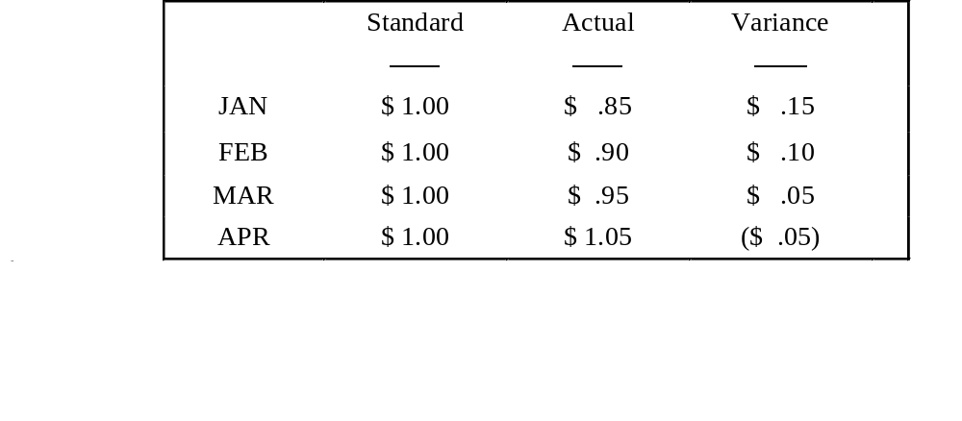
Variance Analysis Does Not Support Kaizen Philosophy
Problems with Traditional MAS
The above data reveals an unfavorable trend, although variances are favorable for the first three months.

Slide 27
When are Standards Useful?
Problems with Traditional MAS
Standards should never be used for performance measurement
Standards are useful for
  Expediting the accounting process
  Approximation of the fair value of inventory
  Regulatory compliance

Slide 28
Traditional Labor Accounting
Problems with Traditional MAS
Traditional definition of direct / indirect labor does not apply in a Lean environment
  Multi-skilled operators are crucial in Lean
  Operators perform 5S, TPM, Set-up, Material Handling
Traditional focus on direct labor ignores other manufacturing costs
  Labor as a % of total cost is usually below 20%
Labor problems will be detected visually in a Lean environment

Slide 29
Traditional Scrap Reporting
Problems with Traditional MAS
Scrap tickets are required to be costed at stage of completion in a traditional environment
  Requires excess clerical help
  Requires detailed routings to be maintained
One - piece flow in a Lean Environment
  Volume of scrap is reduced (batch of one)
  Eliminates the need for detailed costing
  Scrap costed out at raw material stage or finished level of completion

Slide 30
Traditional Capital Justification
Problems with Traditional MAS
Traditional Capital budgeting methods:
  Capital project should achieve a targeted payback
By viewing capital projects as ‘investments’ we ignore other critical factors:
  Impact on customer service
  Mixed model production
  “3P” considerations
Focusing on payback encourages over-purchasing of machine capacity & speed

Slide 31
How Lean Impacts the Management Accounting Systems (MAS)
Lean Fundamentals
Problems with Traditional MAS
Lean Impact on MAS
Objectives:
Discuss impact of Lean on overhead costing structure
Discuss product costing in a Lean environment
Identify non-financial measures in a Lean environment
Identify questions accountants must ask

Slide 32
Impact of Lean on Overhead Costing Structure
Lean Impact on MAS
Organization refocuses its attention to the shop floor
Functional/ centralized groups are redeployed directly to Lean cells/ Teams
Examples include:
  Purchasing
  Production control
  Manufacturing Engineering
  Industrial Engineering
  Quality Control
  Tool Design
  Cost Accounting

Slide 33
Lean Refocuses Attention to the Factory Floor
Lean Impact on MAS
Shop Floor
President

Slide 34
Impact of Lean on Overhead Costing Structure (Con’t)
Lean Impact on MAS
Lean Teams take on the form of a factory within a factory
Redeployment provides
  Greater focus on issues/ opportunities
  Opportunity to control one’s destiny
  Enhanced level of control over a wider span of operations
  Greater sense of ownership
  Problem detection and resolution is immediate

Slide 35
Impact of Lean on Overhead Costing Structure (Con’t)
Lean Impact on MAS
Accounting implications
  Overhead costs are now associated with a Lean cell
  Arbitrary allocations of overhead costs is no longer required
  More accurate costs
Overhead costs can be better traced to particular products

Slide 36
Impact of Lean on Overhead Costing Structure (Con’t)
Lean Impact on MAS
For cost collection purposes
Each Lean cell is set up as a cost department in the accounting system
As more cells are added, so are cost departments
Each Lean cell prepares ‘Bottom-Up” budgets

Slide 37
Product Costing in a Lean Environment
Lean Impact on MAS
For product costing purposes, overhead is classified into two cost pools:
Cell Costs | Support Costs
Those costs that can be traced directly to a cell | Those costs that are not directly traceable to a Lean cell. These need to be allocated to particular cells.
Includes: Cell Management salaries Labor Costs Tooling Machine Depreciation Supplies | Includes: Centralized support costs Heat treating General maintenance Plant depreciation Taxes/insurance Centralized manufacturing management
Note that both fixed and variable costs are included here

Slide 38
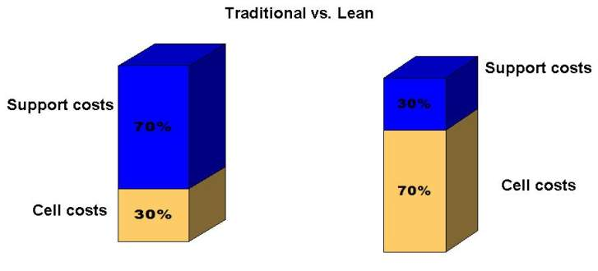
Overhead Cost Analysis
Lean Impact on MAS

Slide 39
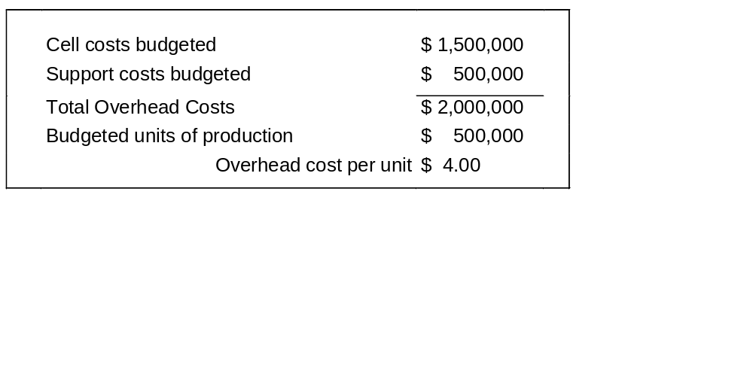
Product Costing Example
Lean Impact on MAS
Support costs are allocated to each cell
Although allocations are required, costs are easier to assign because of cell layout
There is a direct cause/effect relationship

Slide 40
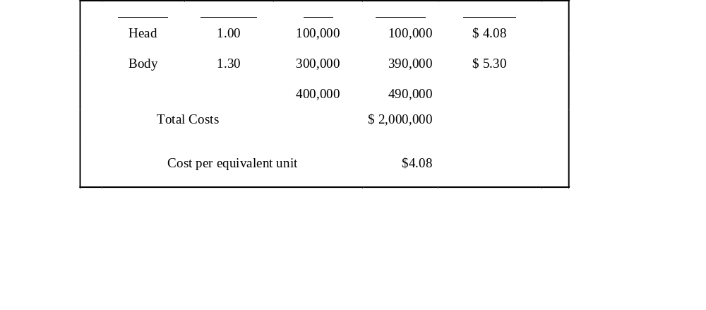
Product Costing Example
Lean Impact on MAS
Parts produced in a cell may not be homogeneous in terms of resources required
Parts should be grouped into categories
Assign equivalent unit factors to these parts

Slide 41
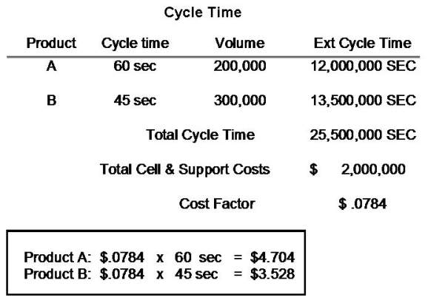
Product Costing Example
Lean Impact on MAS

Slide 42

Non-Financial Measures in a Lean Environment
Lean Impact on MAS
Units produced per man hour
  World class - 2% improvement/ month
Customer service trends
  Percent past due/fill rate
Days inventory on hand
Quality rejects
  Pareto analysis
Employee suggestions
Daily production status
Purchasing measurements
Supplier performance
Scrap units/ dollars
Kaizen results

Slide 43
Things to Keep in Mind
Lean Impact on MAS
Changes to the Management Accounting System (MAS) do not
happen overnight!
As the organization changes, the MAS should reflect and compliment the new organizational structure
As Lean is implemented, changes to the MAS will evolve in a common sense manner to fit the needs of your company
Changes to the MAS should follow, not lead Lean

Slide 44
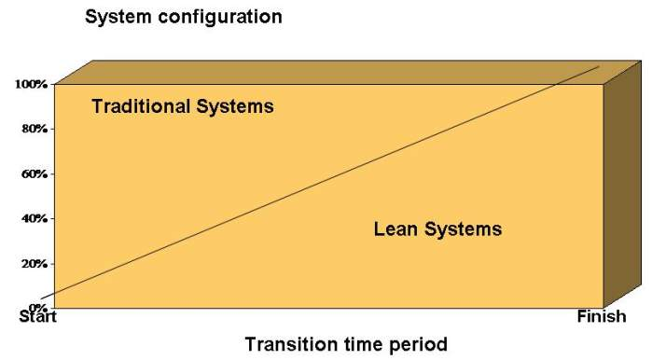
Transition Period Lean Conversion
Lean Impact on MAS

Slide 45
Accountants Must Ask the Following Questions
Lean Impact on MAS
Who uses the information provided?
Why is this data required?
What would happen if this information is no longer provided?
Is the data being imposed, or is someone asking for it?
Are decisions being made from the information?
Does the info support company goals?
Are we collecting information that tells us something we already know?

Slide 46
Accountants Must Ask the Following Questions
Lean Impact on MAS
Are there other measures that will better aid the manufacturing group to monitor performance?
  (Including non-financial measures)
Do the measures reflect continuous improvement trends?
Is the information timely?
WHO IS YOUR CUSTOMER?

Slide 47
Accountants Must Ask the Following Questions
Lean Impact on MAS
There are financial implications to a Lean implementation
As inventory is reduced, unfavorable absorption variances will impact the bottom line
Additional Lean implementation costs will also impact financial performance
  Lean training
  Plant clean-up
  Plant rearrangement
  Write-off of “discovered” obsolete inventory

Slide 48
Summary Thoughts
Lean Impact on MAS
Get educated in Lean - hands-on approach
Be a business person, not a scorekeeper
Kaizen the financial process so you’ll have more time to focus
on the business
Identify your customers and understand their needs
Keep it simple

Slide 49
Other Modules In This Series:
5S
Standard Work
Total Productive Maintenance (TPM)
Administrative Lean
Cell Design/ Production Preparation Process (3P)
Kaizen
Kanban
Problem Solving
Poka Yoke Quality Systems
Transaction Process Improvement (TPI)
Cause & Effect Diagram with the Additions of Cards (CEDAC)
Single Minute Exchange of Dies (SMED)
Value Stream Mapping (VSMi®)
Visual Management
Managing Daily Process Excellence
For More Information Please Contact:
Mark DeLuzio, President and CEO
+1.860.234.0915
mark.deluzio@leanhorizons.com
Strategically Creating Value Through the Elimination of Waste

